Slide 1
Detection of false data injection on IEEE 14 bus
Prashant Mishra – 521218
Harshit Paurwal – 521140
K abhishek raj - 521143
Faculty supervisor –
Asst. prof. Phani krishna karri
Eee department

Slide 2
CONTENT
Introduction
Factors affecting voltage
FLOWCHART
Advantages of having such a model
Summary

Slide 3
Introduction
In the realm of power grid security, ensuring the integrity and reliability of electrical systems is paramount. With the rise of cyber threats and potential attacks on power infrastructures, it has become crucial to develop robust methods for identifying and mitigating anomalies in voltage data. In this project, we address this challenge by leveraging machine learning techniques, specifically Long Short-Term Memory (LSTM) neural networks, to classify voltage data into two categories: nominal voltages and "attacked voltages" – those compromised by noise or anomalies.
Our dataset comprises two types of voltage readings: nominal voltages, which represent standard operational conditions, and voltage readings that have been subjected to various forms of interference or attacks, resulting in deviations from normal behavior. By training an LSTM model on this dataset, we aim to create a classification system capable of distinguishing between these two categories with high accuracy.

Slide 4
Factors affecting voltage
Load Variations: Fluctuations in electricity demand can lead to changes in voltages across the grid. High loads can cause voltage drops, while low loads may result in voltage spikes.
Network Impedance: The impedance of transmission lines and other network components can impact voltage levels. High impedance can lead to voltage drops, especially over long distances.
Faults and Disturbances: Short circuits, line faults, equipment failures, and other disturbances can introduce anomalies in voltage readings.
Environmental Conditions: Environmental factors like temperature, humidity, and atmospheric conditions can influence the performance of electrical equipment and, consequently, voltage levels.
Cyber Attacks and Cybersecurity Threats: Malicious cyber activities targeting power grid infrastructure can lead to voltage anomalies and disruptions, posing significant security challenges.

Slide 5
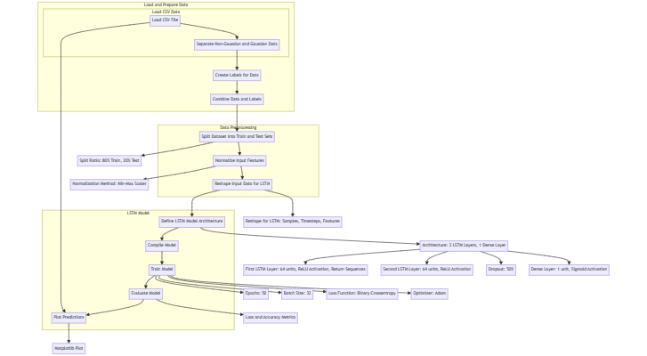
FLOWCHART

Slide 6
ADVANTAGES
Early Detection of Anomalies: The LSTM model enables early detection of anomalous voltage behavior, allowing power grid operators to swiftly identify and respond to potential threats or disturbances before they escalate into critical issues.
Improved Resilience: By accurately classifying voltage data, the model enhances the resilience of the power grid against cyberattacks and other forms of interference. –
Enhanced Grid Monitoring: Integrating the LSTM model into existing grid monitoring systems provides real-time insights into voltage variations, facilitating proactive maintenance and troubleshooting activities.
Reduced Operational Costs: By automating the detection and classification of voltage anomalies, the model reduces the need for manual intervention and on-site inspections.
Adaptability to Evolving Threats: The LSTM model can be continuously trained and updated with new data, allowing it to adapt to evolving threats and changing patterns of voltage anomalies over time.

Slide 7
Preprocessing the data
The code uses Min Max Scaler from scikit-learn to scale the input features. Min Max Scaler scales the features to a specified range, typically [0, 1], preserving the relationships between data points.
It is mentioned that Min Max Scaler is preferred over Standard Scaler for LSTM neural networks due to its ability to maintain the relative differences in feature values, which can lead to improved accuracy.
Normalization:
The input features are normalized using Min Max Scaler to ensure that they fall within a consistent range, which is important for training neural networks effectively.
Reshaping for LSTM Format:
After scaling, the input data is reshaped to fit the LSTM format, which expects input data in the shape of (samples, timesteps, features).
The reshaping ensures that the input data is structured appropriately for sequential processing by the LSTM network.
Printing Dimensions:
Finally, the code prints the dimensions of the reshaped training and test data to verify that they match the expected format for LSTM input.

Slide 8
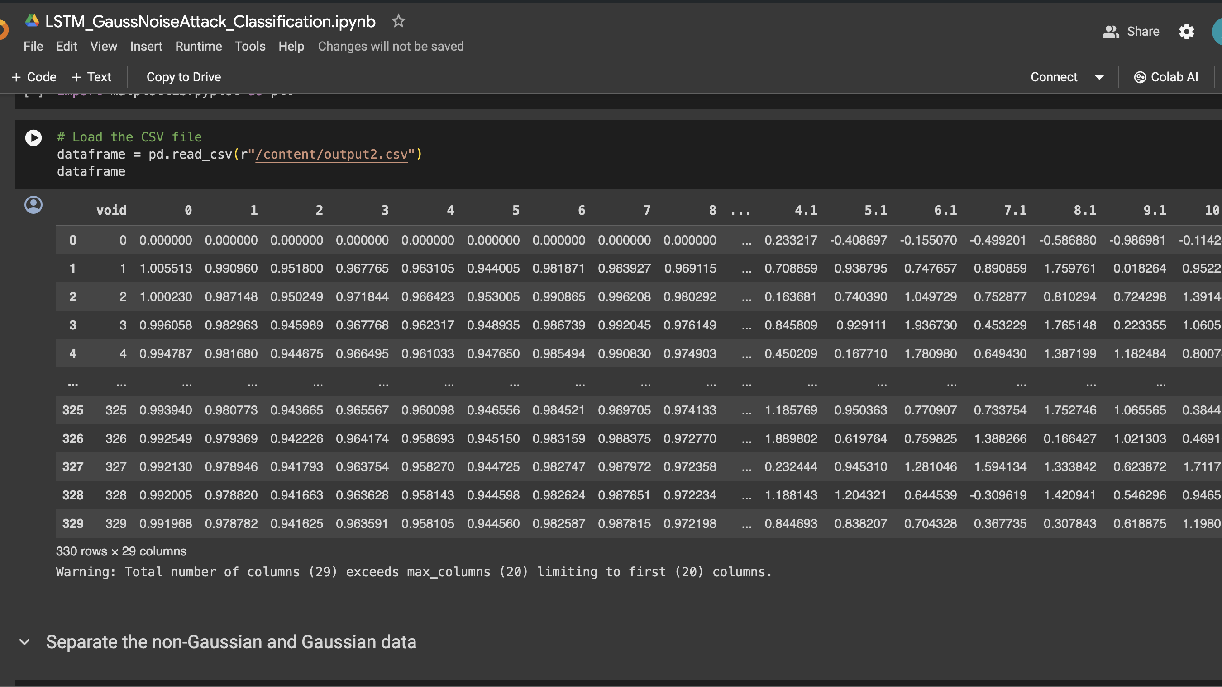

Dataset

Slide 9
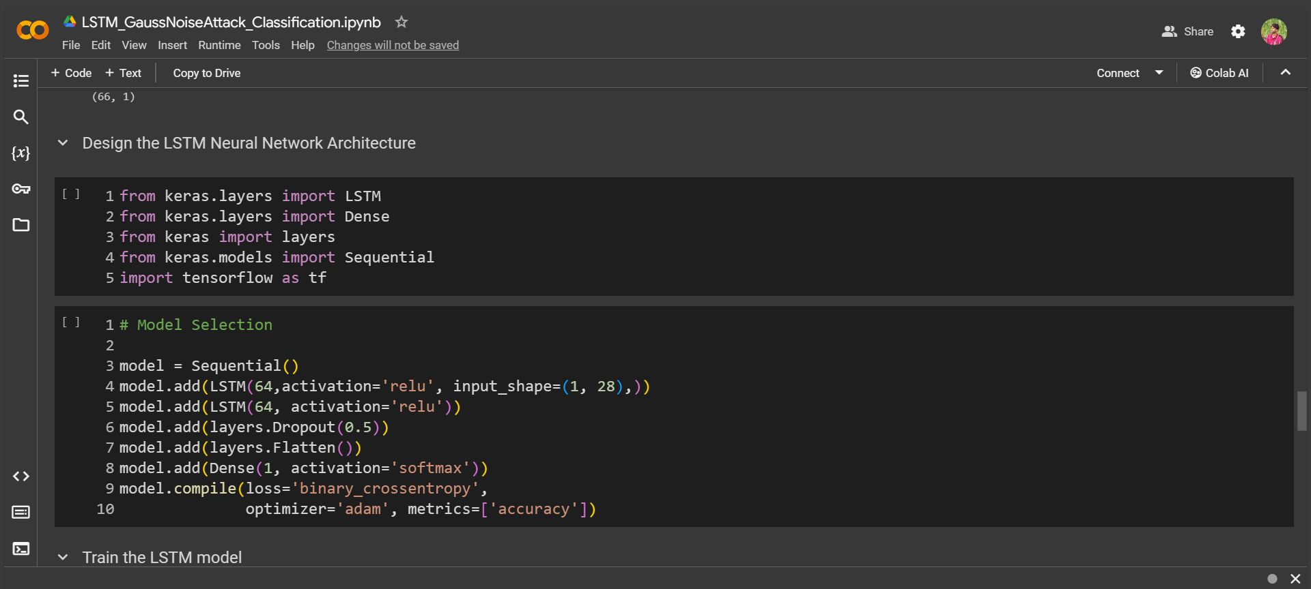
LSTM MODEL

Slide 10
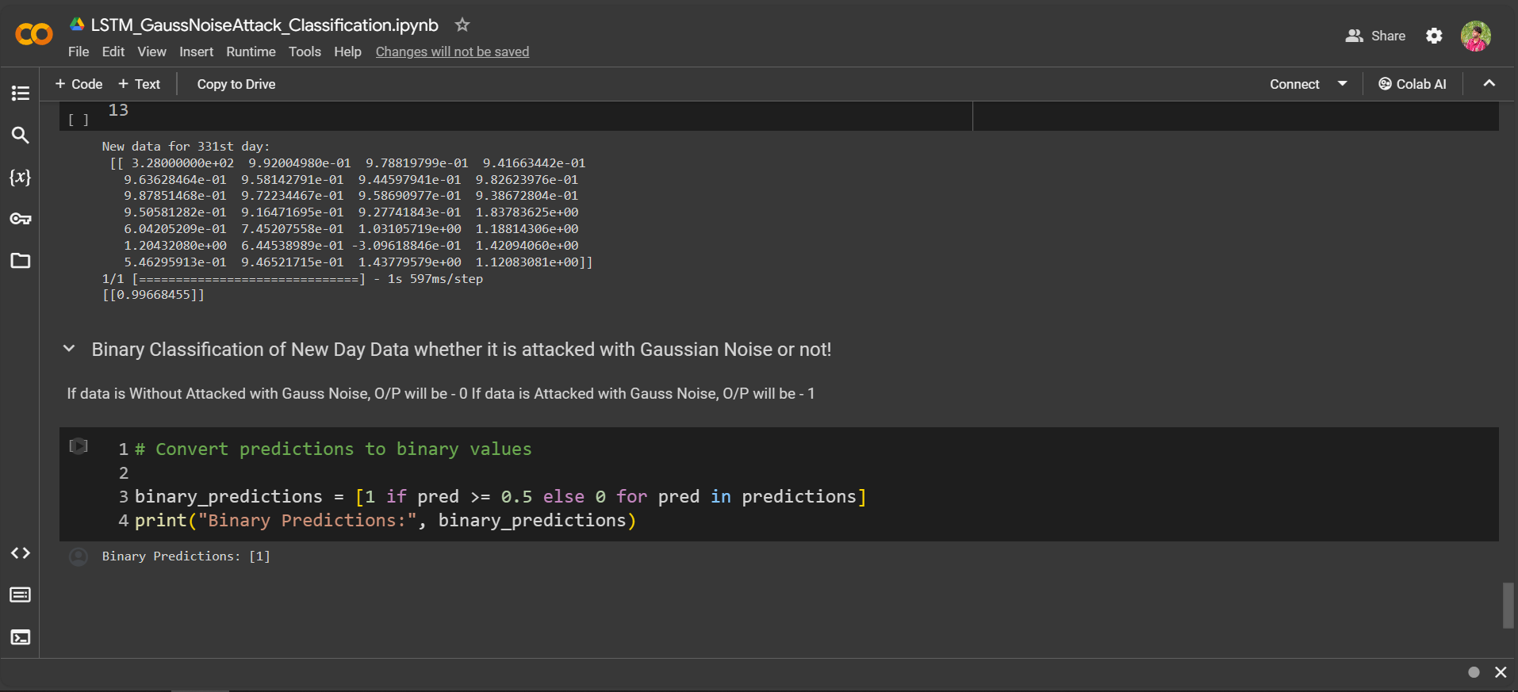
MODEL output parameters

Slide 11
CONCLUSION
In conclusion, we've embarked on a journey into the fascinating world of LSTM-based binary classification models. Through the exploration of uncommon terminologies and practical insights into model training and evaluation, we've gained a deeper understanding of the intricacies involved in building and deploying advanced neural networks as we reflect on the significance of LSTM networks in sequential data modelling. This visualization serves as a tangible representation of our model's efficacy and provides valuable insights for further refinement.
Colab link: https://colab.research.google.com/drive/1jDFD26bZ1XmDtZljJJv4W7TnQc_pxFr6?usp=sharing

Slide 12
FUTURE WORK
Temporal Attention Mechanisms:
Incorporate temporal attention mechanisms within the LSTM architecture to focus on relevant parts of the input sequence while making predictions. Attention mechanisms dynamically weigh the importance of different time steps in the input sequence, allowing the model to attend to the most informative features at each time step. By integrating temporal attention mechanisms, the model can potentially improve its performance in tasks involving long sequences or where certain parts of the input sequence are more relevant than others.
Transfer Learning with Pretrained Embeddings:
Explore transfer learning techniques by leveraging pretrained embeddings or representations learned from large-scale datasets or domain-specific corpora. Pretrained embeddings capture semantic relationships and contextual information present in the input data, which can be beneficial for tasks with limited labeled data or in domains where data is scarce. By fine-tuning the LSTM model using pretrained embeddings, the model can potentially achieve better generalization performance and faster convergence on the target task.

